Slide 1
Handling and installation manual for MIK flooring
Page 1
Handling of MIK flooring
Please transport the panels carefully. Do not expose the panels to excessive forces such as impacts. Move the pallets with the panels in accordance with forklift operating standards; do not shift the pallet with the panels by using only the tips of the forks.
If you do not install the panels immediately:
Please store the panels appropriately.
The panels should be protected against direct sunlight and excessive heat.
Pallets can be stacked 3 high; no additional loading allowed.
Do not remove the plastic shrink wrap material until panels are to be installed.
Please remove the plastic shrink wrap carefully using a knife, ensuring that you do not cut the panels (scoring the plastic might result in a “rated breaking point”!).
Do not throw the panels.
When temperatures are below 0°C/32°F, you have to bring the panels into the heated stable/barn. In this case do not install the panels immediately. You should not start with the installation before the material has reached a temperature above 10°C/50°F. If the air temperature is higher than 30°C/86°F, you should not start with the installation before the temperature of the material has sunk below 25°C/77°F, otherwise the panels may not fit properly.

Slide 2
Handling and installation manual for MIK flooring
Page 2
Installation Guidelines for MIK Flooring
Please use only suitable tools for the installation of the panels.
Always use a rubber hammer, never use a metal hammer!
Do not hit the panels with full force.
When installing the panels, please make sure they are assembled unstressed.
Never try to adjust an assembled panel by using a lever tool. No big pressure is required! Normally the panels can be installed without too much force.
Make sure to always use 5 mm thick supporting beams to guarantee the perfect interlocking of flooring and beams.
The ledge (2”/50mm) for the beam support must be completely flat to avoid tilting and give the construction the best possible stability.
Do not fix the beams to the walls. Plastic slats always have a small movement due to expansion or contraction depending on temperature changes.
Please fix other material to the flooring only by using MIK’s special floor anchors.
Farrowing crates should be fixed only to the supporting beams. Only use special anchors that have a flat contact side to the beams, otherwise beams could get damaged.

Slide 3
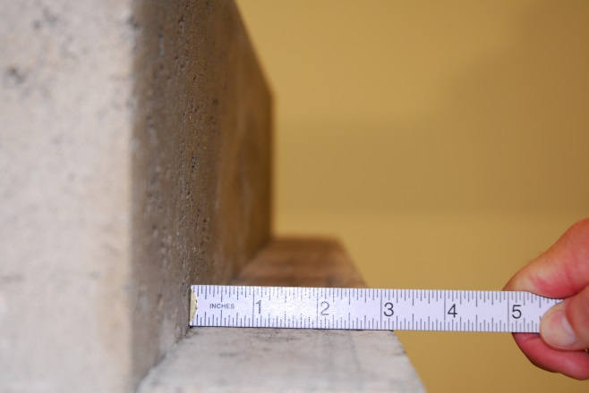
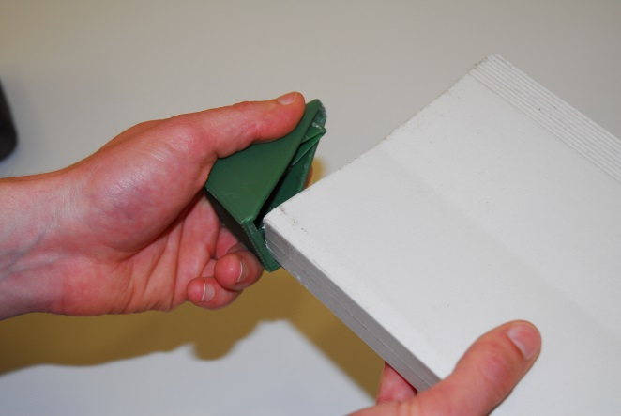
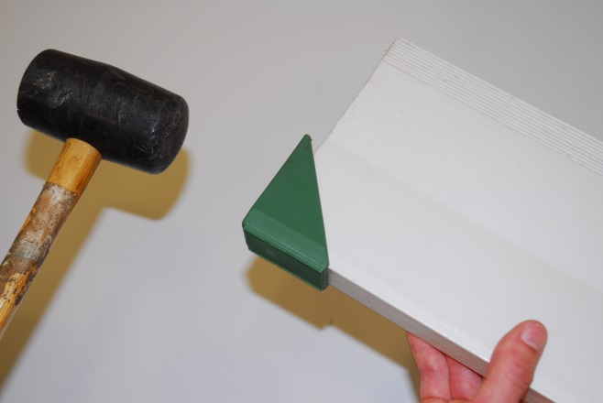
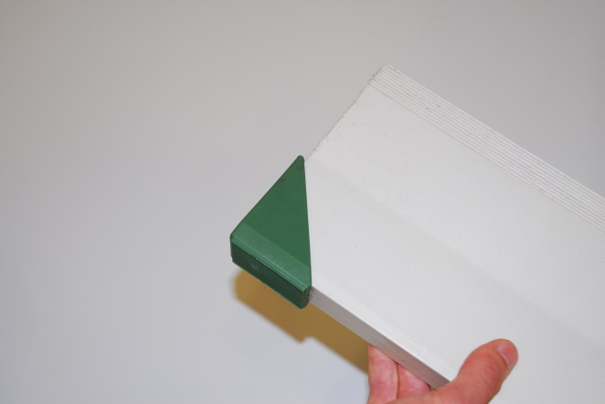
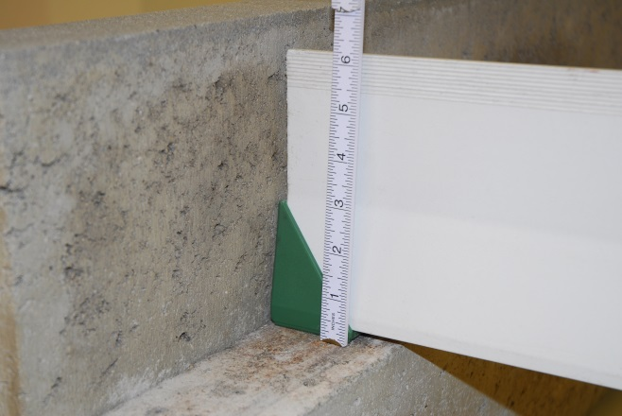
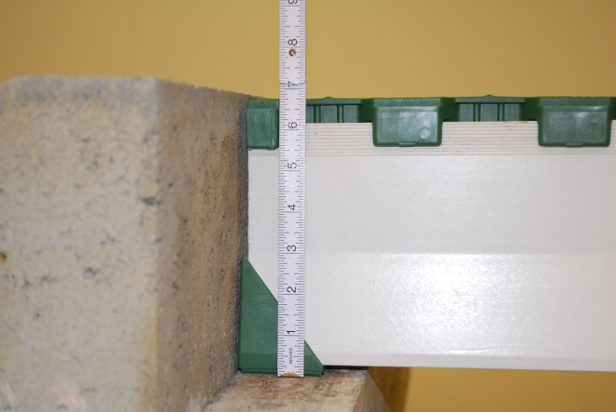
Handling and installation manual for MIK flooring
Page 3
MIK DUO - Bedding and construction height
Picture 1
Picture 2
Please make sure to have a minimum bedding surface of 5 cms or 2“! Here is where the strength is getting transmitted to the basic structure!
It is absolutely necessary to always use DUO Protect. This is to avoid damage of the supporting beam by rough concrete.
Picture 3
Picture 4
Assemble DUO Protect straight on the beam end and hammer on it carefully until it fits perfectly.
......done! Perfect result.
Picture 5
Picture 6
Pay attention to the total construction height of the DUO beams, DUO Protect and the flooring. The surface of the flooring should always be 5 mms beneath the level of the concrete walkways or surfaces.
This is important especially where animals have access to such crossovers, due to the danger they can lift up the flooring!

Slide 4
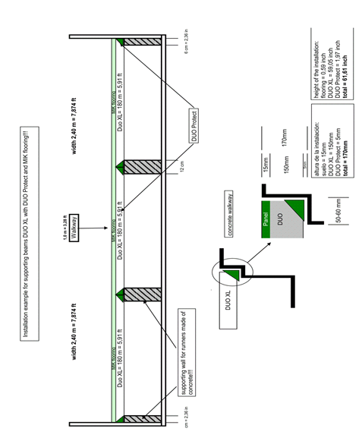
Handling and installation manual for MIK flooring
Page 4

Slide 5
Handling and installation manual for MIK flooring
Page 5

Slide 6
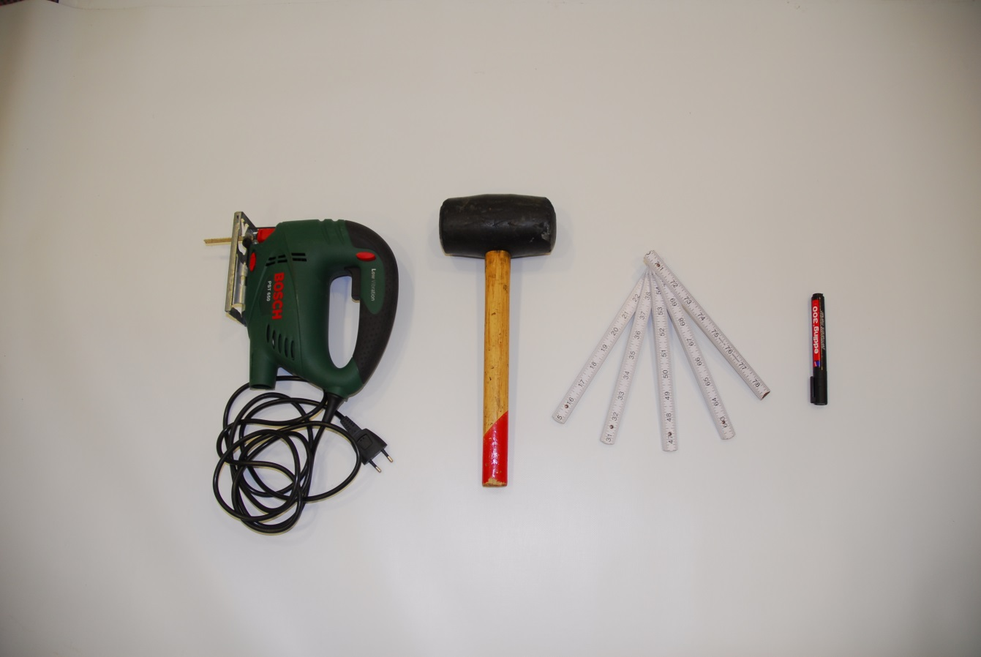
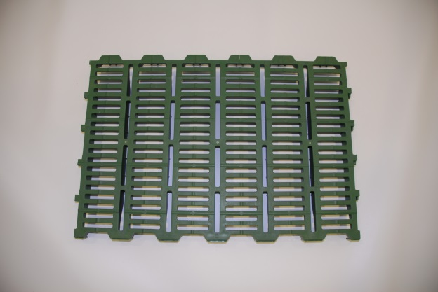
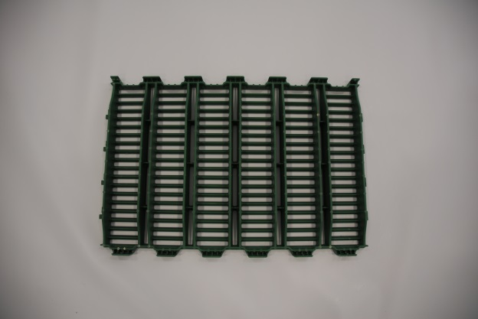
Handling and installation manual for MIK flooring
Page 6
Guidelines for cutting MIK Flooring
Tools required:
Marker
Folding ruler
Rubber hammer
Jigsaw
Picture 1
Picture 2
Flooring top side
Flooring bottom side

Slide 7
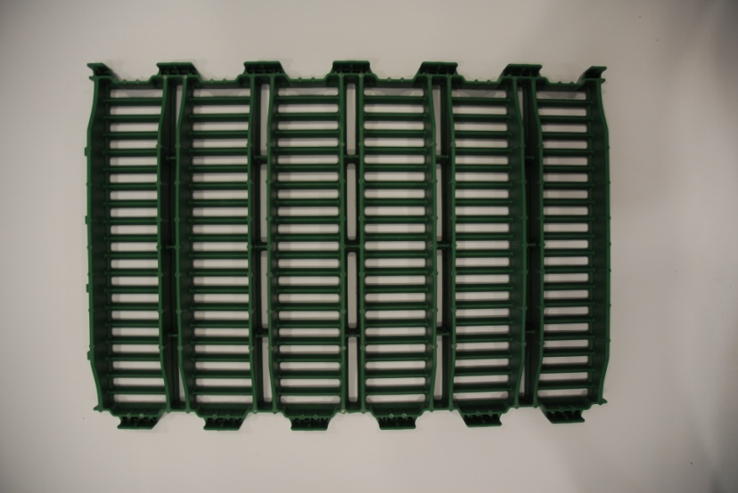
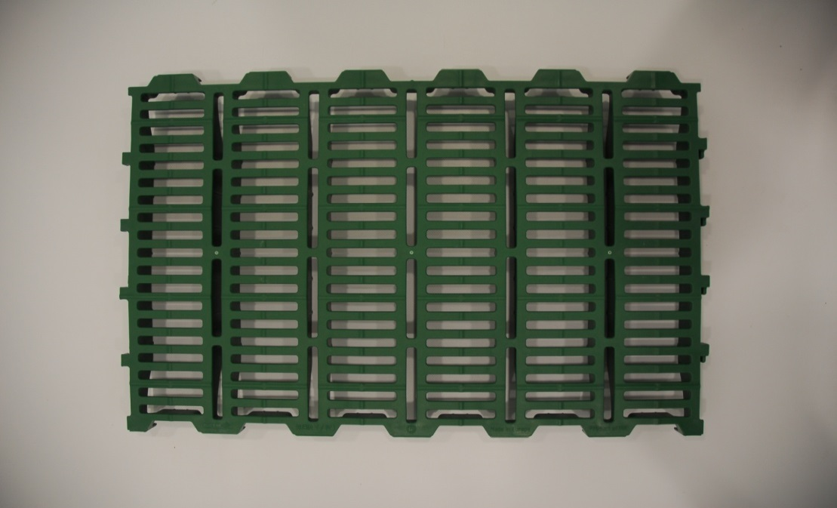
Handling and installation manual for MIK flooring
Page 7
The flooring can be cut ONLY between the twin walls you can see on the bottom side. If you cut it somewhere else the carrying capacity will be strongly influenced!!!
Picture 3
Where to cut MIK flooring
(Principle is valid for all types of MIK flooring!)

Slide 8
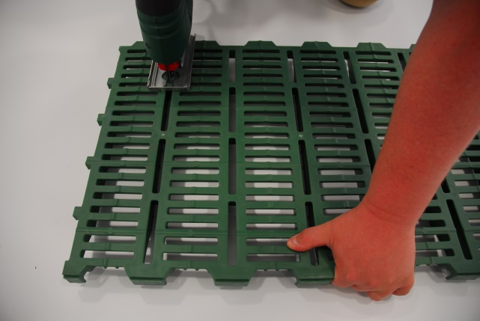
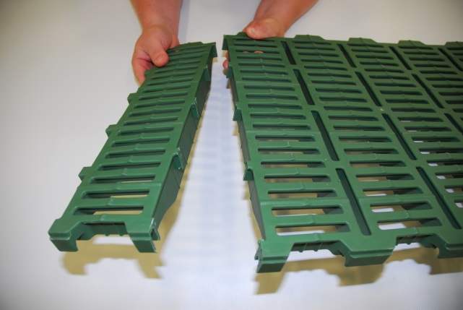
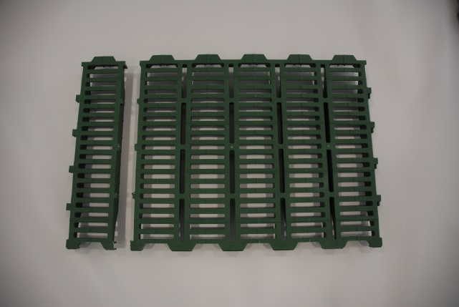
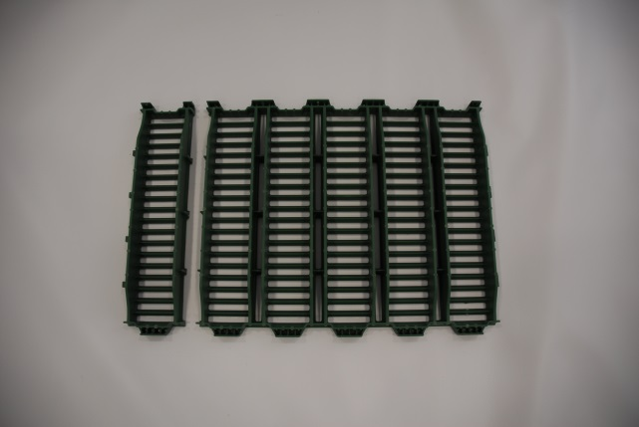
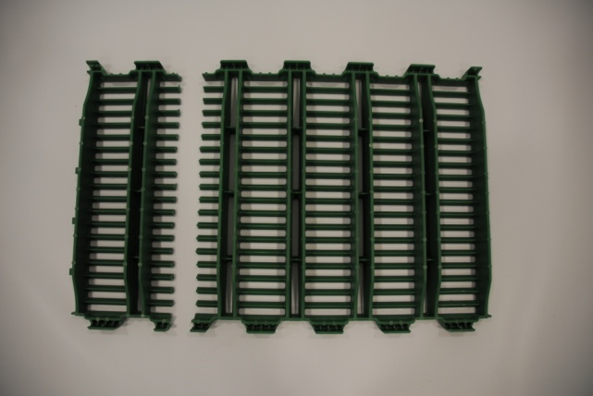
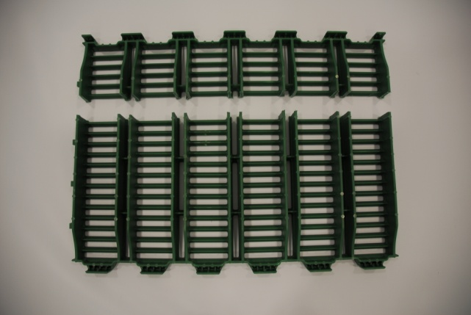
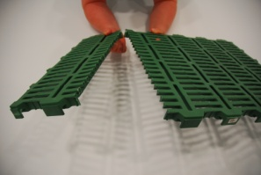
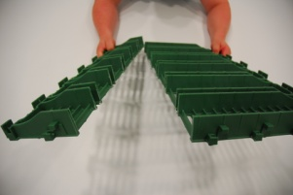
Handling and installation manual for MIK flooring
Page 8
Picture 4
Picture 5
Correct application of the saw
Correct result!
Picture 6
Picture 7
Picture 8
Picture 9

Slide 9
Handling and installation manual for MIK flooring
Page 9

Slide 10
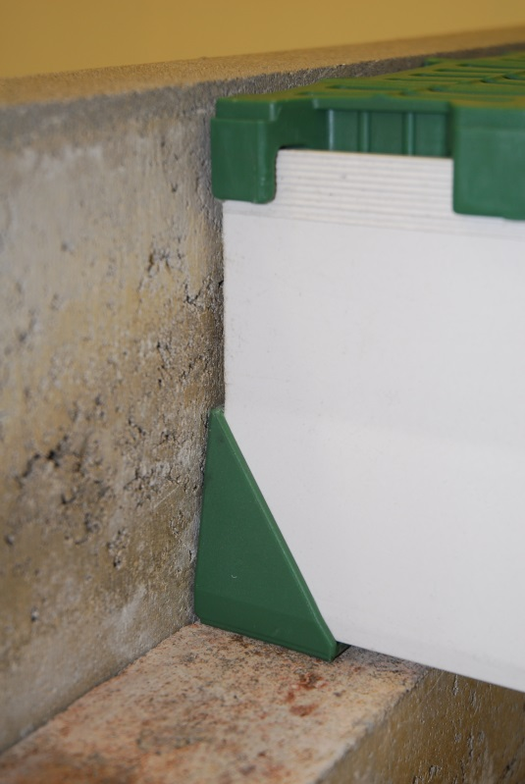
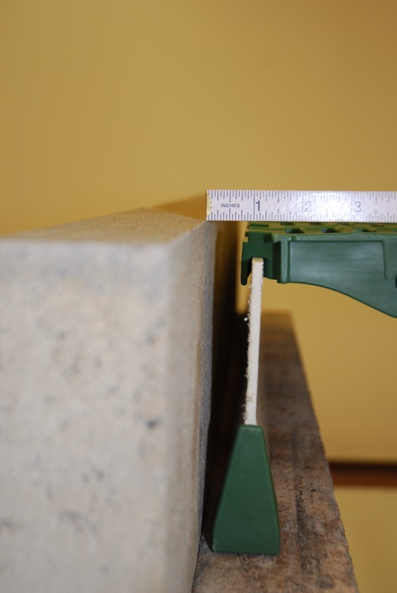
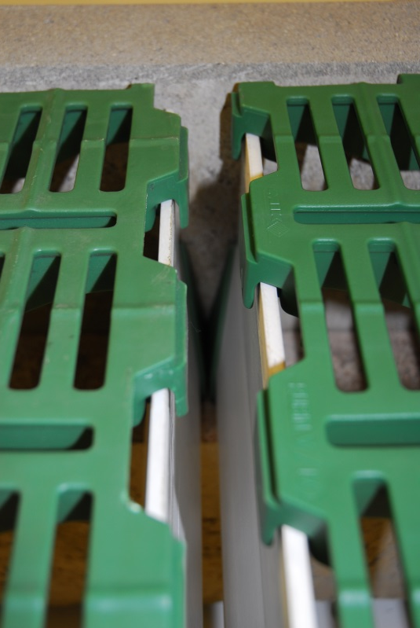
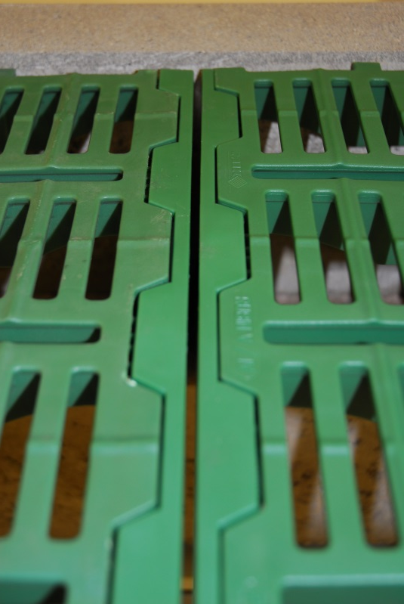
Handling and installation manual for MIK flooring
Page 10
Expansion gaps and clearances
Picture 1
Picture 2
2,5 cms or 1“ space to any wall is required!
The surface of the flooring must be 5 mms beneath
the boarding of concrete walkways or surfaces.
Picture 3
Picture 4
For flooring surfaces wider than 15 m it is necessary to install an expansion gap by using a double supporting beam! Please always have a look at the MIK layout scheme. Expansion gaps are marked in there!
Please always use our edge strip to finish the flooring installation on the sides!

Slide 11
Handling and installation manual for MIK flooring
Page 11
Dismantling of a single panel
To take a single panel out of the assembled flooring, it is necessary to remove the corresponding row. The following steps have to be considered:
Put your feet on the outer edges of both rows which are adjacent to the panel/row you want to remove.
Start dismantling the panels at the beginning of the row you want.
Lift the panel until it is detached from the beam. Proceed with this on the opposite side of the panel until the entire panel is completely detached from the beam.
Unlock the panel from the following one and remove it.
Repeat these steps until you reached the panel you want to remove or until you finished dismantling the row. Please make sure not to treat the panels with full force or to „lever“ them since the interlocking system between the panels can only be unlocked by lifting the whole panel one side at a time from the support beams.

